Slide 1

PREDICTIVE ANALYTICS FOR STUDENT RETENTION
ISM6562-BIG DATA FOR BUSINESS(FINAL PROJECT)_ TEAM CHAMPION

Slide 2
TEAM CHAMPION
Satyasrirama Siva Krishna Sanam - U19448106
Manoj Kumar Katakam - U87407224
Jayanth Uppara - U46027839
Bojanapally Santhoshini - U88362375

Slide 3
CONTENTS
INTRODUCTION
BUSINESS PROBLEM
EXISTING SOLUTION
METHODOLOGY
MODELLING TECHNIQUES
MODEL SELECTION
FUTURE SCOPE

Slide 4


INTRODUCTION
Why this dataset?
Background: Educational institutions are increasingly dependent on data to predict student outcomes and enhance retention strategies.
Objective: To utilize PySpark's capabilities in processing large educational datasets to predict student dropout and academic success effectively.
Value Proposition: Implementing this predictive model can optimize interventions, increase retention rates, and personalize student support.

Slide 5

BUSINESS PROBLEM
High student dropout rates challenge educational effectiveness and economic stability.
Dropouts affect institutional reputation, financial health, and student personal growth.
Can we accurately predict which students are at risk of dropping out using available data?

Slide 6
EXISTING SOLUTION & NECESSITY FOR A NEW MODEL
Existing Model Limitations
Used basic ML techniques without support for large-scale data.
Faced issues with scalability and performance.
Advancements with New Model
Integrated PySpark for efficient handling of large datasets.
Adopted advanced ML algorithms and techniques to develop a better model.

Slide 7
METHODOLOGY
Integration of data from academic records, socio-economic backgrounds, and behavioral data.
Utilizing PySpark for efficient handling and processing of large-scale data, ensuring robust data integrity and speed.
Deployment of various machine learning techniques to identify potential dropouts early in their academic journey.

Slide 8
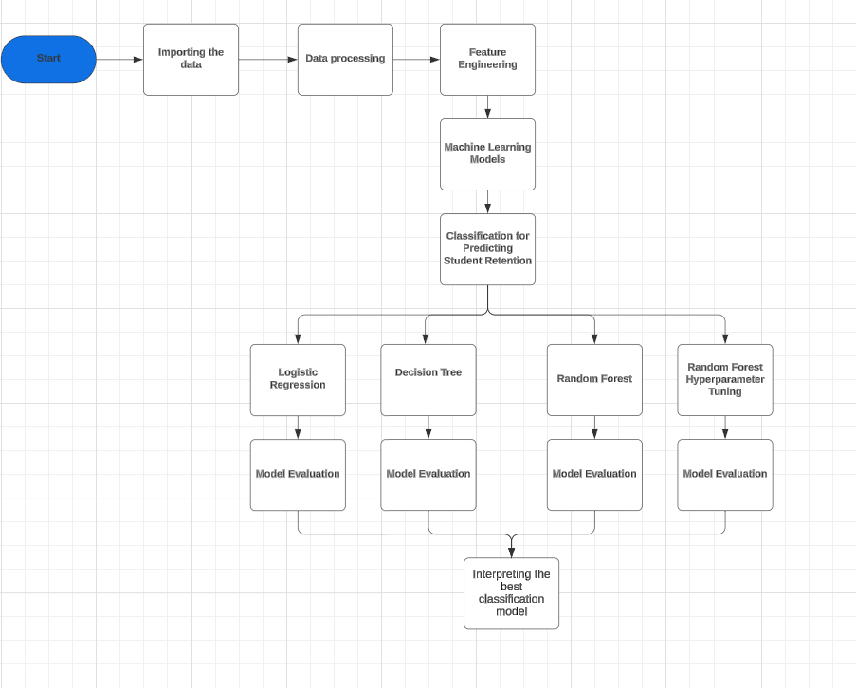
Data Model

Slide 9

UNDERSTANDING SOURCE DATA
What source?
UCI ML repository: An open-source repository providing a diverse range of datasets specifically designed for educational research and analysis.
Student Retention and Academic Success Dataset: Dataset developed within the framework of a project aimed at reducing dropout and failure rates in higher education, supported by SATDAP program under grant POCI-05-5762-FSE-000191, Portugal.
What type is our source data?
Classification Data: The data is structured for a three-category classification task with the target column of cardinality 3.
Target Outcomes:
Dropout: The student discontinues their studies, hence classified as a dropout.
Enrolled: The student is still enrolled by the end of the course, hence not dropped out.
Graduate: The student successfully completes the course and graduates.

Slide 10

ATTRIBUTE INFORMATION
Feature Name | Feature Description
Marital Status | Indicates the marital status of the student
Nationality | The student's nationality, reflecting diverse backgrounds
Gender | The gender identity of the student
Age at Enrollment | Age of the student at the time of enrollment
Course | The specific course or program the student is enrolled in
Application Mode | How the student applied to the institution
Application Order | The priority or order of application among multiple choices
Previous Qualification | The highest qualification obtained before current enrollment
Previous Qualification (Grade) | Grades associated with the previous qualification
Mother's Qualification | Educational qualification of the student's mother
Father's Qualification | Educational qualification of the student's father
Mother's Occupation | The occupation of the student's mother
Father's Occupation | The occupation of the student's father

Slide 11
ATTRIBUTE INFORMATION
Feature Name | Feature Description
Tuition Fees Up to Date | Whether tuition fees are paid up to date
Scholarship Holder | Indicates if the student is receiving a scholarship
Debtor | Indicates if the student owes any debts to the institution
Daytime/Evening Attendance | Whether the student attends daytime or evening classes
Curricular Units 1st/2nd Sem | Detailed metrics of academic involvement and performance over the first and second semesters
Unemployment Rate | Regional unemployment rate, indicating economic conditions that might affect student success
Inflation Rate | Inflation rate at the time of study, providing context on economic stability
GDP | Gross Domestic Product, reflecting the economic environment surrounding the educational sector
Displaced | Indicates whether the student is displaced due to any reason
Educational Special Needs | Whether the student has any special educational needs
International | Whether the student is an international student
Target | The classification outcome for each student – dropout, enrolled, or graduate

Slide 12


Slide 13
Modelling Techniques & Performance Tunning
Classifier Model
Logistic Regression
Decision Tree
Ensemble Techniques
Random Forest

Slide 14
Choosing the Best Metrics for Our Models
False Positive Error: The model predicts that a student will drop out, but in reality, they continue their studies.
Cost: Misdirected resources, unnecessary interventions, potential stress or stigma for the student.
False Negative Error: The model predicts that a student will continue their studies, but in reality, they drop out.
Cost: A missed opportunity for timely intervention, leading to actual dropout which could have been preventable, loss of student potential and institutional reputation.

Slide 15
Graphs- Bar plot of Precision Score for various models

Slide 16
Model Selection and Performance
Description | Accuracy | Recall | Precision | F1 Score
Logistic Regression | 71.61% | 71.61% | 68.43% | 67.18%
Decision Tree | 71.49% | 71.49% | 70.67% | 68.69%
Random Forest | 71.85% | 71.85% | 76.88% | 65.37%
Random Forest Ht | 73.99% | 73.99% | 72.53% | 71.34%
Best Model
Random Forest seems to be the best model for our data set Best Precision
Precision = 76.88%

Slide 17
Conclusion
PySpark's robust data processing capabilities enable the development of accurate predictive models that can significantly reduce dropout rates and personalize student support.
Encourage institutions to adopt advanced data analytics to transform educational outcomes through targeted interventions.

Slide 18

FUTURE SCOPE
Improvements: Exploration of neural networks and deep learning models to enhance prediction accuracy.
Integration: Potential to integrate the predictive model with student management systems for real-time analytics and interventions.
Expansion: Explore other areas of application such as predictive maintenance of institutional resources and facilities.

Slide 19
Thank you!
-Team Champion

